Slide 1
CHAPTER 2 : EXPLORE THE IT INDUSTRY
What is a company?

Slide 2

OBJECTIVES FOR THIS SESSION
Define a company and explain its purpose
Understand the different functions of a company

Slide 3



What do you remember from the video?
ACTIVITY 1
20 MIN
How did trade develop at the beginning of human history?
Who created the new idea of business in 1896?
They invented the concept of “fictitious, invented identity”, what does it mean?
How are the taxes a company has to pay calculated?

Slide 4







The concept of company over time
EXPLAIN
10 MIN
1896
Trade of goods based on value system
Individuals can create companies that have a different identities than theirs
Lower risk by legal invention Several people can own the same company: they share assets and management
Entrepreneurs invent engines and import more and more goods
business = entrepreneur so they risk if their business is not successful
Companies pay taxes based on their incomes

Slide 5




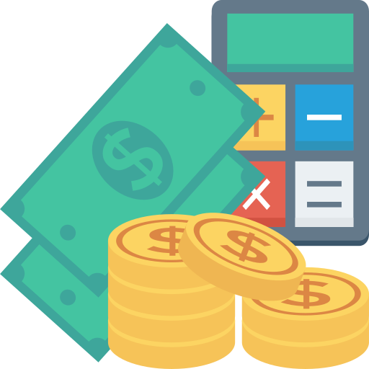

Info to know about a company
EXPLAIN
10 MIN
Products and services
Missions and
values
Targeted market
Competition
Financial performance
Future prospects
Notes:
There are many things that a student should know about a company, but here are some of the most important:
The company's mission and values: What is the company's purpose? What are its core values?
The company's products or services: What does the company do? What products or services does it offer?
The company's target market: Who are the company's customers? What are their needs and wants?
The company's competitive landscape: Who are the company's competitors? What are their strengths and weaknesses?
The company's financial performance: How is the company doing financially? What are its revenue and profit margins?
The company's future prospects: What are the company's growth plans? What are its challenges and opportunities?

Slide 6

Info to know about a company
EXPLAIN
10 MIN
Aged between 18 to 45
Live in a city
Active on Facebook
Have a smartphone and knowledge to use mobile applications
Service: Delivery of food and groceries
Bringing good food into your everyday
Food Pandamart:
Reduce costumers’ waiting time to 25min
10% online grocery market
Foodpanda's revenue is $1.9 Billion (2022)
TADA, GRAB, Meal Temple, E-Gets, Muuve and many more.
Notes:
There are many things that a student should know about a company, but here are some of the most important:
The company's mission and values: What is the company's purpose? What are its core values?
The company's products or services: What does the company do? What products or services does it offer?
The company's target market: Who are the company's customers? What are their needs and wants?
The company's competitive landscape: Who are the company's competitors? What are their strengths and weaknesses?
The company's financial performance: How is the company doing financially? What are its revenue and profit margins?
The company's future prospects: What are the company's growth plans? What are its challenges and opportunities?

Slide 7

ACTIVITY 2
Getting to know a company
30 MIN
TO COMPLETE THIS ACTIVITY :
1
TEAM WORK
2
CLASS PRESENTATIONS
(20 min)
(20 min)

